Slide 1


Slide 2

Best Pharm
Best Pharm is a medicine distributor that resolves to all its healthcare needs of its patients
Patient can book an appointment with the doctor and the doctor can prescribe medicines to them.
Prescribed medicines are available with the in-store inventory or returned medicines inventory.
Patients can donate medicines that they no longer require to Best Pharm, Best Pharm managers examine for expiration and send it for testing, after the testing team gives approval, it is sent to inventory.

Slide 3
Problem Statement
Medicines nowadays cost a fortune to buy and you always don’t need all of them for your treatment.
Sometimes a doctor prescribe you medicines only for a particular time periods and then advices you to discontinue them after you are treated.
What if you have bought 10 packets and you have only used 2?
You can donate the extra packets through BestPharm to patients in need

Slide 4
Approach
For effectively managing the incoming donations of item, the managers from best pharm are give the responsibility to check for the expiration and directly send it to disposable team.
Rest of the medicines are sent for further testing and then sent to inventory
Three major work queues handle the (1) Donations, (2) Approvals from manager to inventory and (3) disapproval of manager to send it to disposable.

Slide 5
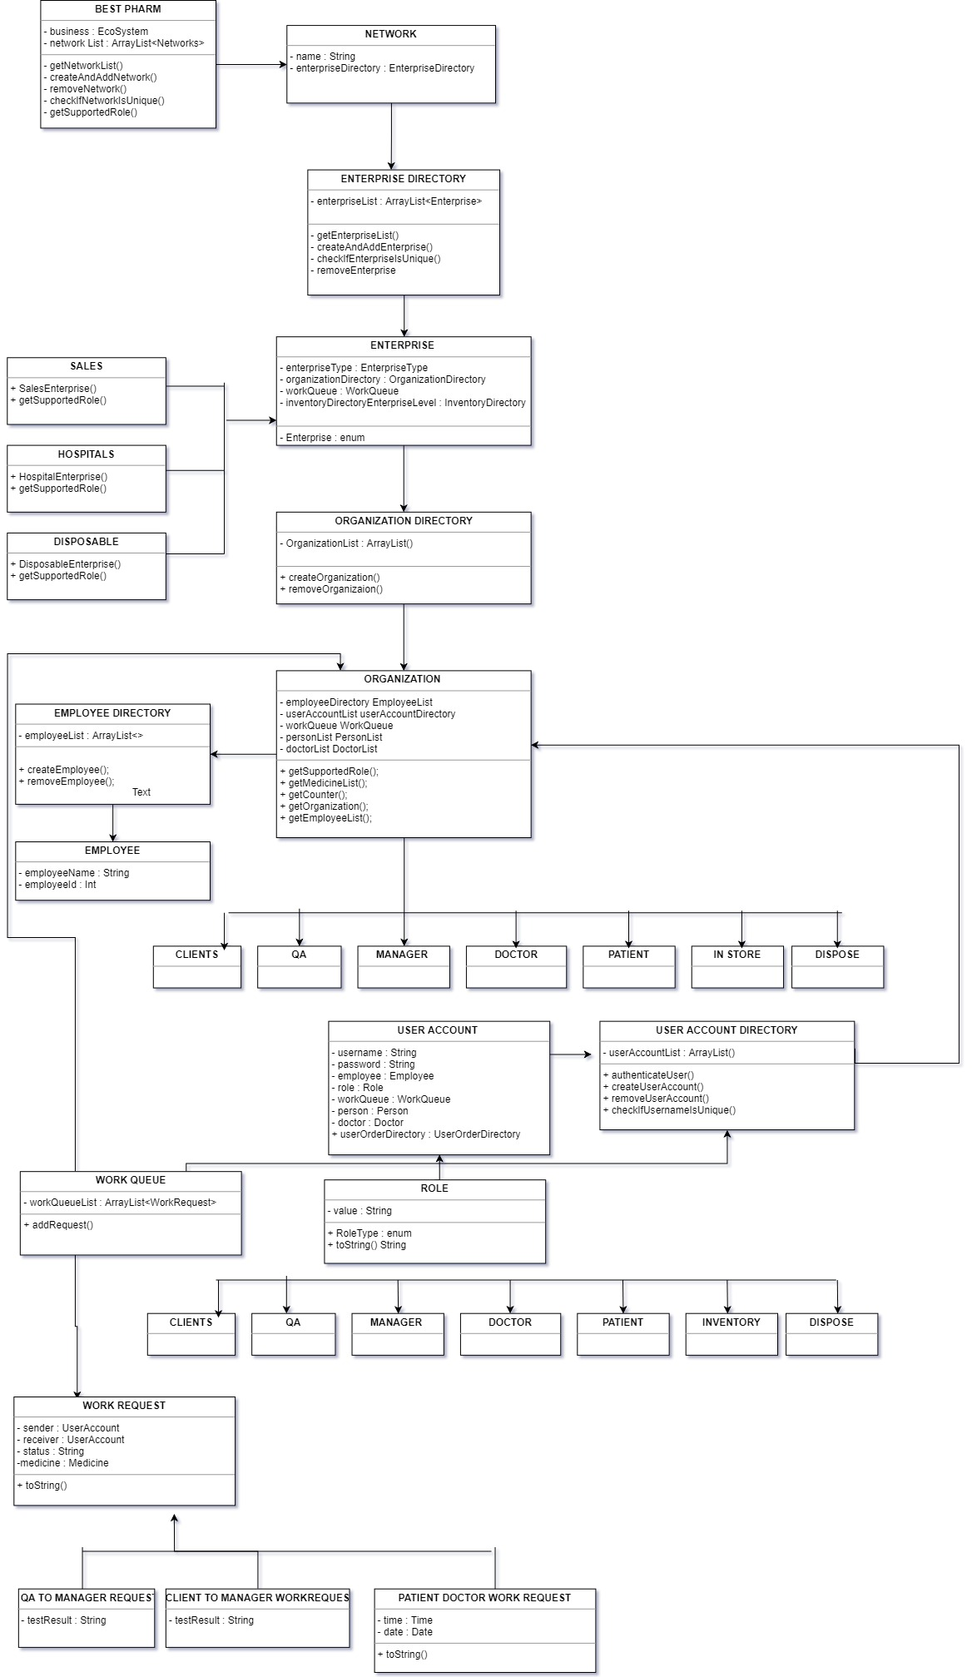
Object Model

Slide 6
Use Cases
Patients can book an appointment with doctor
Doctors can approve the request
Doctors can prescribe medicines to patients
Doctor can view a patient’s history
Patients can order medicines from in-store or used medicines inventory
Patients can donate medicines
Managers can send donated medicines to testing team
Testing team can approve or disapprove the medicines

Slide 7
Use Cases
Manager can then approve it to be sent in inventory
Disposable team can dispose the medicines rejected by manager
System admin can analyse the ecosystem and create a pie chart on donations by every network
Top ten donated medicines and top 10 ordered medicines are reflected from the system.

Slide 8
ScreenShots

Slide 9
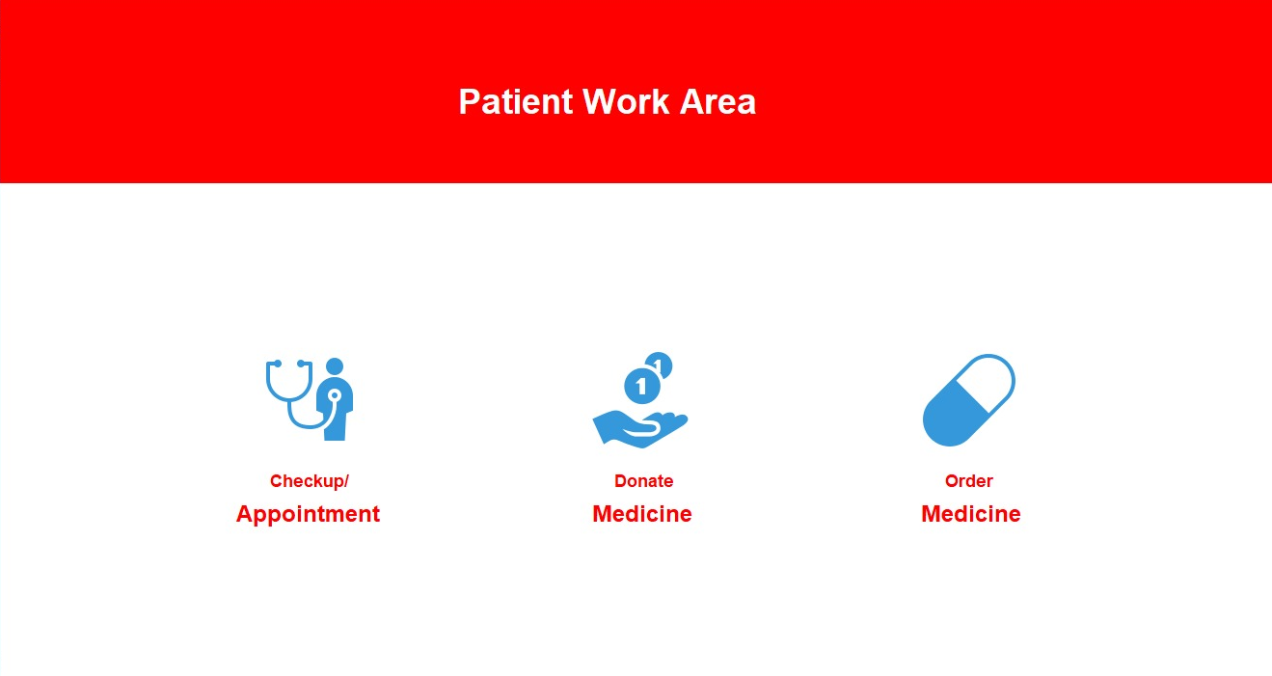

Slide 10
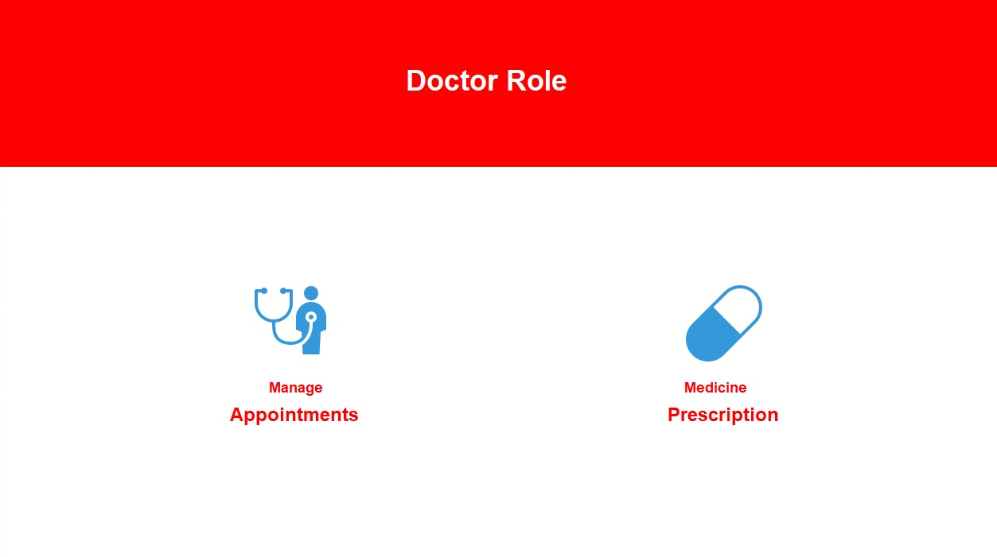

Slide 11
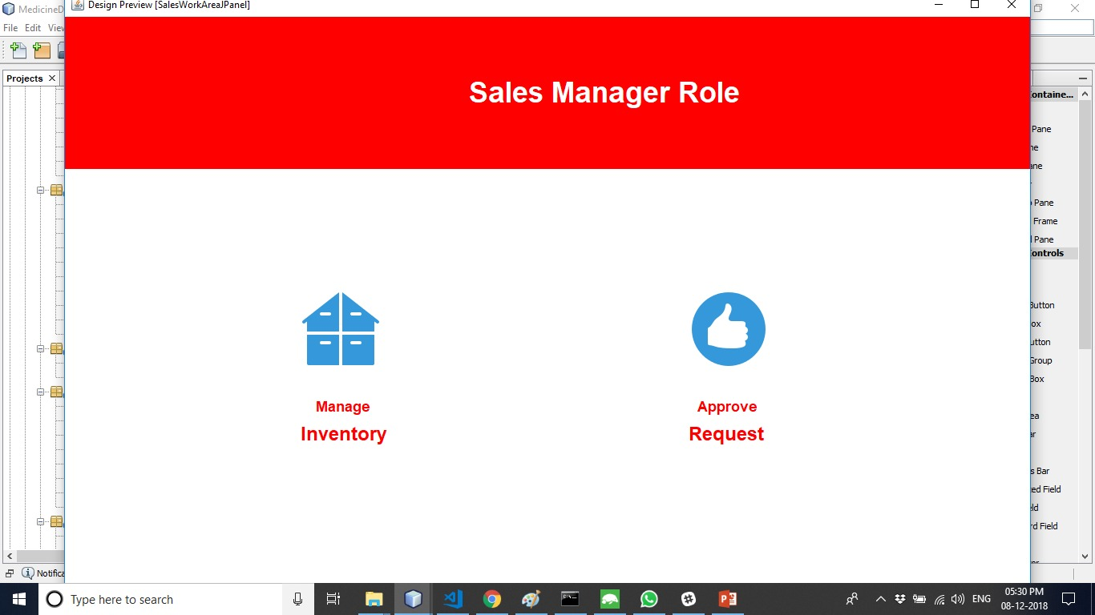

Slide 12
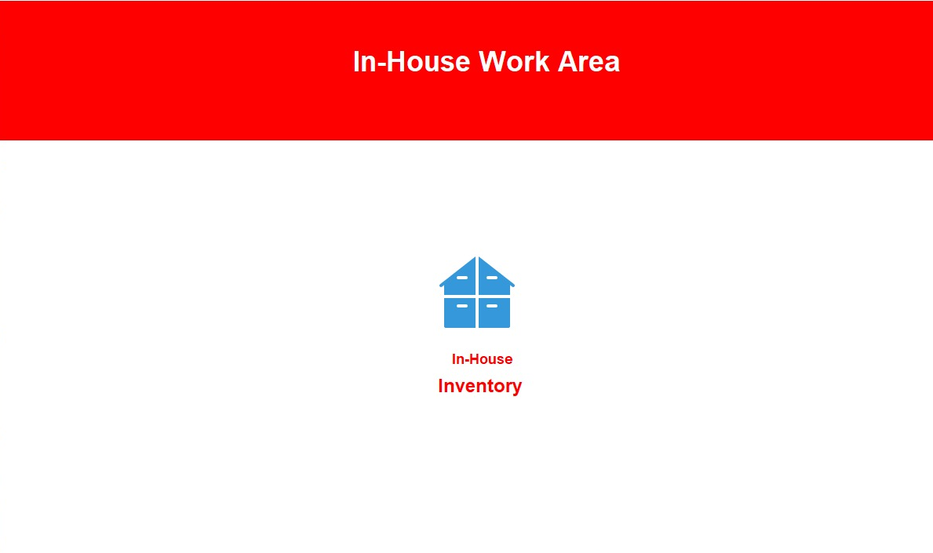

Slide 13
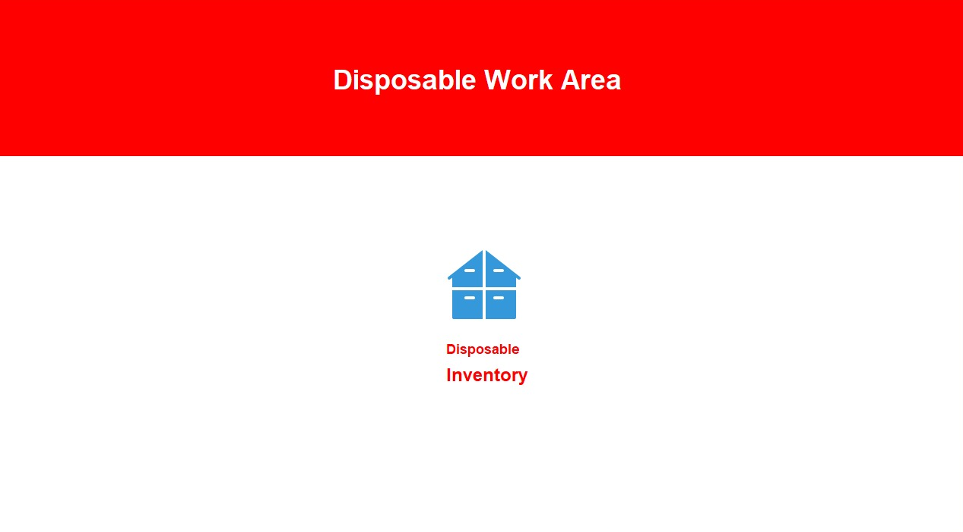

Slide 14
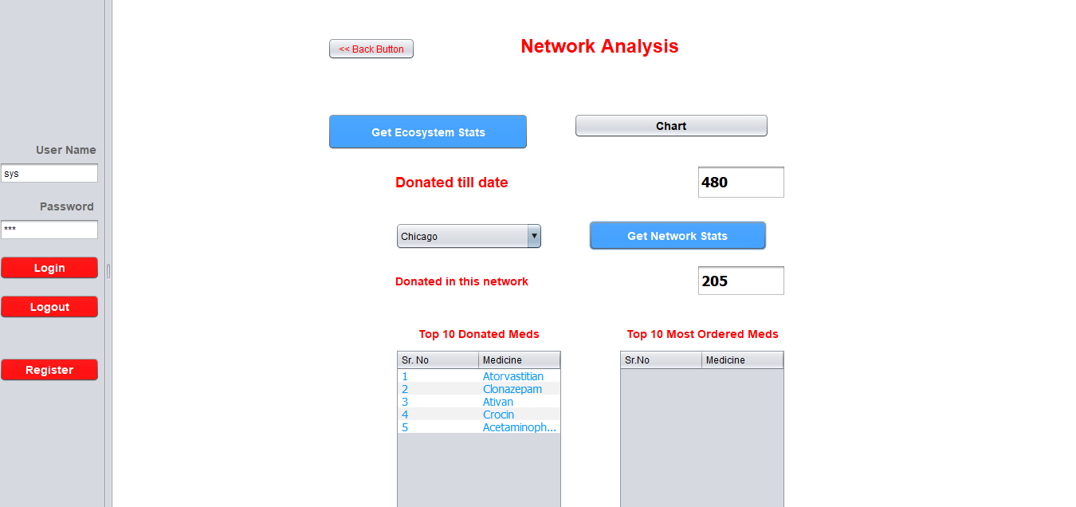

Slide 15
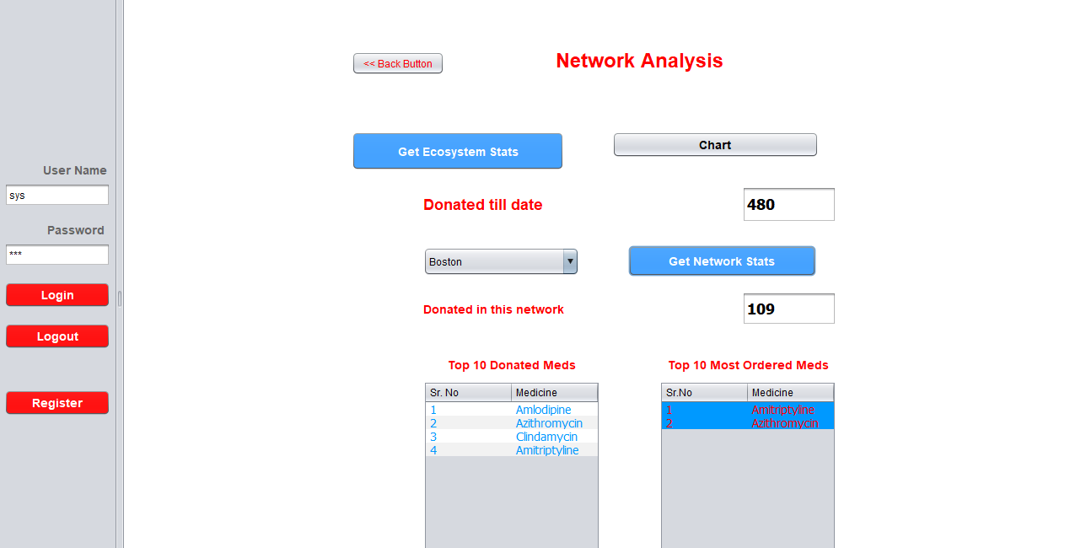

Slide 16
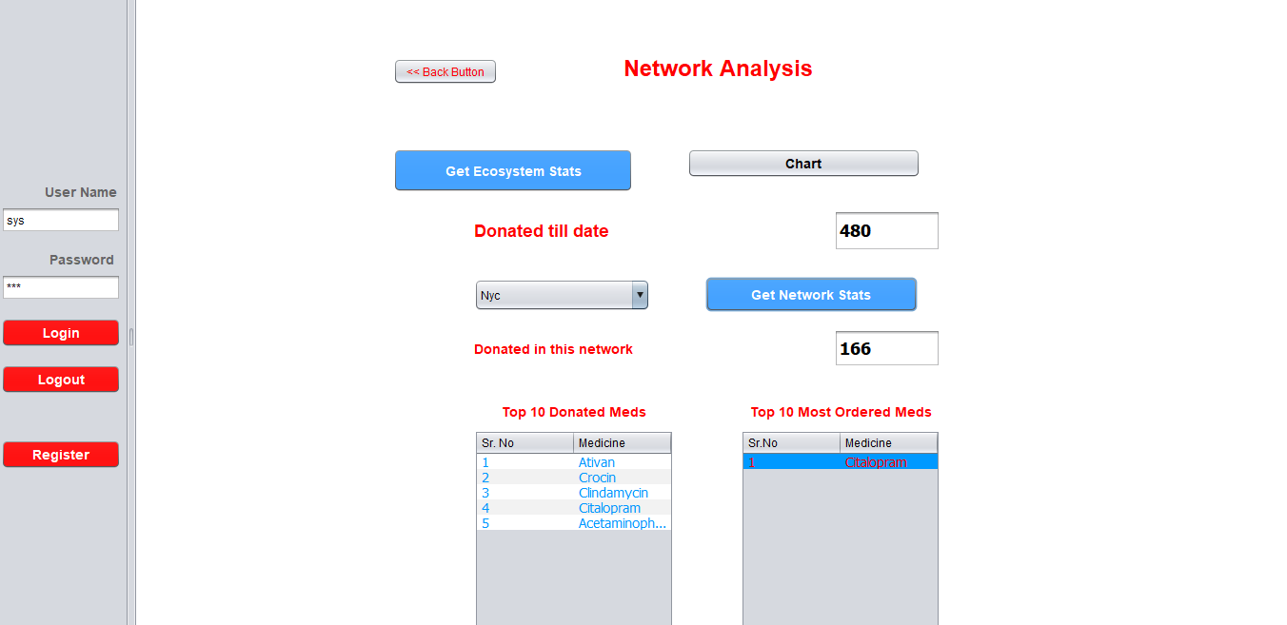

Slide 17
